Slide 1
Orientation to Construction Safety and Life Safety Management
Notes:
Hello, I am the Safety Specialist in the Lancaster General Hospital Safety Department. The information in this presentation is meant to provide guidance on the Lancaster General Health Contractor Safety Management program.

Slide 2
Lancaster General Hospital
Notes:
The purpose of this orientation program is to provide information on Lancaster General Health’s safety, security, and infection control procedures, as well worksite requirements. Upon completion of this review you will be more familiar with these requirements while working in any Lancaster General Health facility.
Lancaster General is a Star Site, recognized through OSHA’s Voluntary Protection Program (VPP). As an OSHA VPP site we want you to be safe while working, so it’s important that you are familiar with safe work procedures and behaviors.

Slide 3
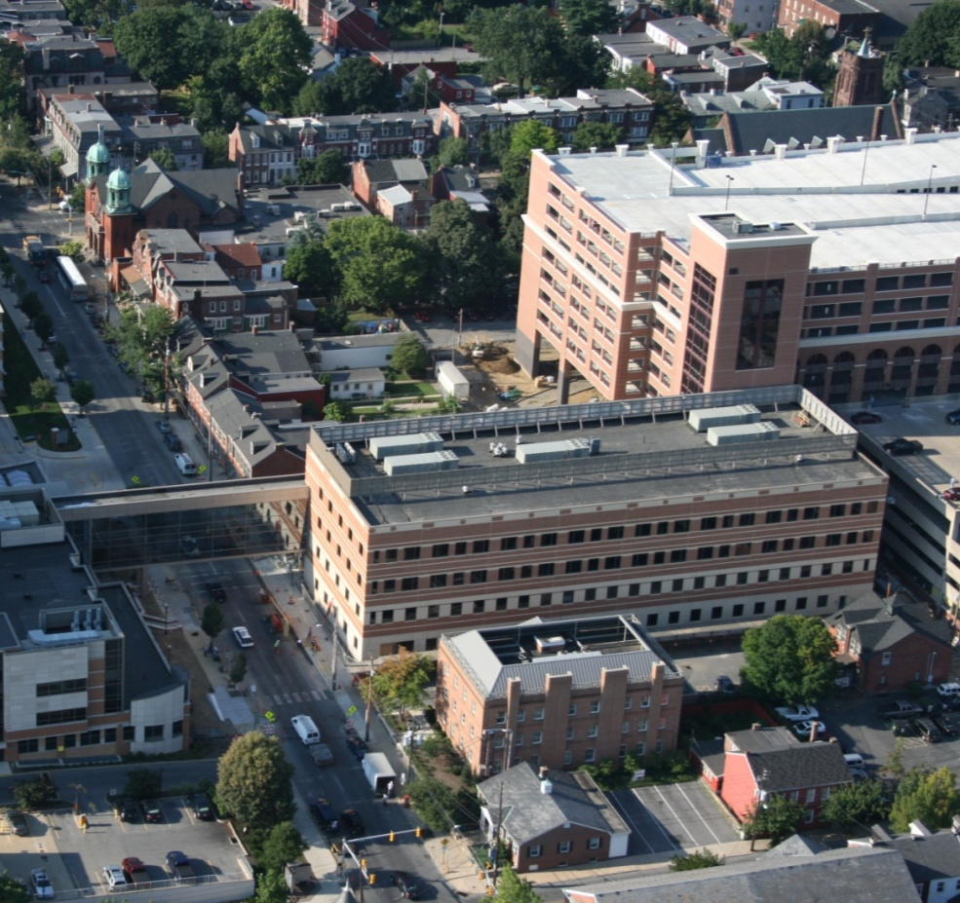
Downtown Pavilion
MISSION:
“To advance the health and well-being of the communities we serve”
VISION:
Delivering on the promise of a healthier future.
Notes:
Lancaster General Health’s mission is “to advance the health and well-being of the communities we serve”. To that end our vision is “delivering on the promise of a healthier future”. As a contractor, you serve a vital role in Lancaster General Health’s ability to create that level of experience.
For contractors, one of the biggest challenges is working in close proximity to patient care areas while not disrupting patient care. In all cases, patient care activities have the highest priority. Every aspect of your work at our facilities, including your conduct on the job, has the potential to affect our operations, so it’s vital that we work together to do all we can to minimize disruption to our patient care services.

Slide 4
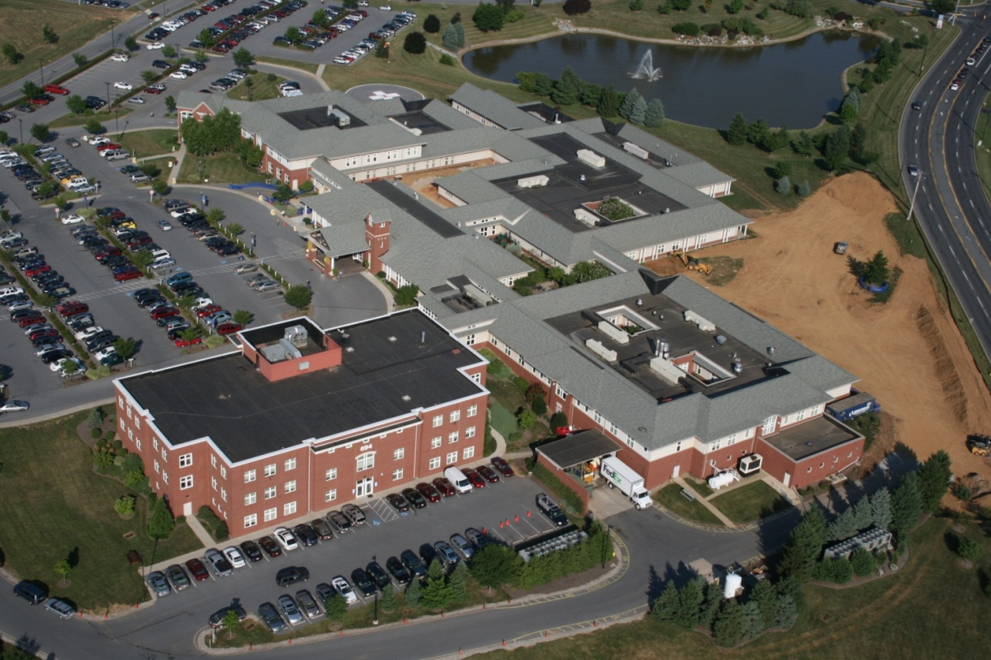
Women’s & Babies Hospital
The Joint Commission
Department of Health
OSHA
Notes:
Lancaster General Health promotes a safe and healthy work environment. Unsafe conditions and unsafe acts can result in property damage or injuries to patients, visitors, employees, volunteers, or contract personnel. Medical facilities operate under strict rules and regulations enforced by several regulatory agencies including the Joint Commission, Department of Health (DOH), and OSHA. Compliance with the regulations set forth by these governing bodies provides guidance on the minimum requirements of safety. In the hospitals, as well as in the outpatient settings, there are additional concerns for security, infection control, and life safety, which require extra awareness and precautions.

Slide 5
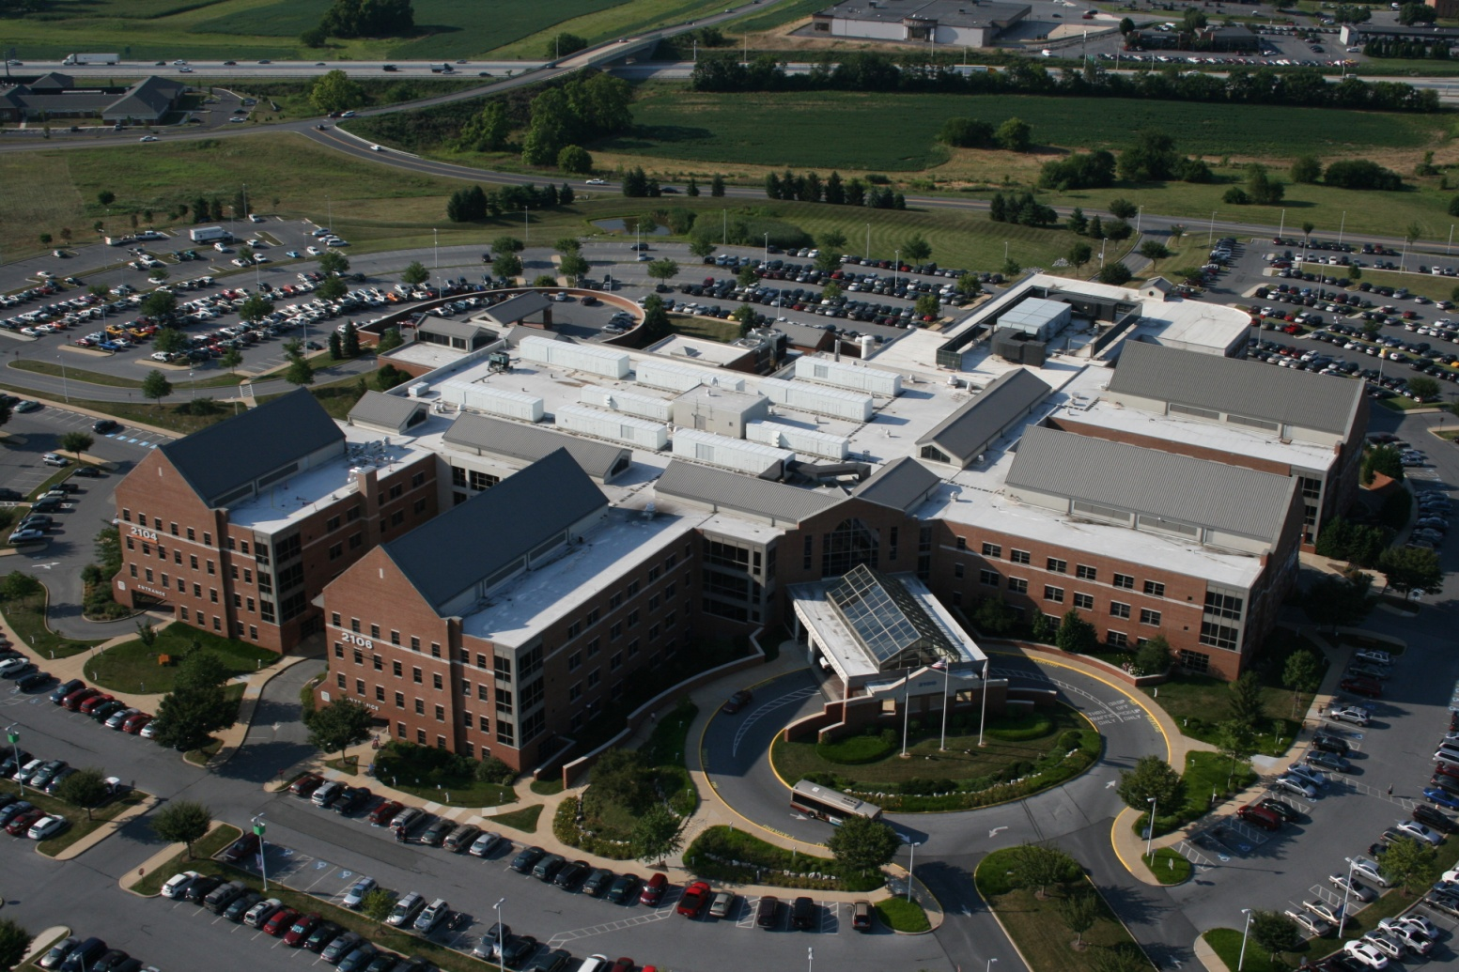
Suburban Outpatient Pavilion
Notes:
The precautions that must be observed while working in Lancaster General Health facilities apply to all contractors and subcontractors who are performing work. General safety orientation is provided in this orientation presentation. Annually, contractors are required to review the “Contractor Safety Management Orientation Manual”. This is to ensure that everyone is familiar with the Lancaster General Health safety standards and are alerted to any changes or new information.

Slide 6
Meet BAXTER
While working in any of Lancaster General Health’s facilities, you may encounter Baxter, the Lancaster General Health Employee Safety Bug.
Notes:
While working in any of Lancaster General Health’s facilities, you may meet Baxter, the Lancaster General Health Employee Safety Bug, pictured here.
Good luck with your assignment. Thanks for working safely and for making sure those around you are also working safely. Your contribution to Lancaster General Health’s safe working environment, as well as to the important services we provide our communities is appreciated.
Let’s continue with orientation by reviewing more detailed information about LGH’s construction safety program.

Slide 7
Construction Project Safety Program
The goal of this program is to provide minimum safe work practice requirements for fire safety, life safety, and environmental health and safety. This program is to be used in combination with the contractors’ own established safety programs and standards.

Slide 8
Objectives of Training
Be aware of basic requirements of the Authorities Having Jurisdiction (AHJs)
Learn about basic safety, security, and infection control measures when working in occupied buildings
Be familiar with Interim Life Safety Measures
Have knowledge of required actions to be taken when life safety features or systems are out of service
Be familiar with key Lancaster General Health Codes and Conditions

Slide 9
Lancaster General Health facilities
Outpatient Centers located at:
Columbia
Crooked Oak
County Line
Eden Physical Therapy
Ephrata
Harrisburg Avenue
Kissel Hill
Lebanon
Manheim
Norlanco
Parkesburg
Willow Lakes
Walter L. Aument
Lancaster General Hospital
Women and Babies Hospital
Suburban Pavilion
Downtown Pavilion

Slide 10
Authorities Having Jurisdiction (AHJs)
The organization, office, or individual responsible for approving equipment, materials, and installation, or a procedure
Department of Health (DOH)
The Joint Commission (TJC)
Occupational Safety & Health Administration (OSHA)
Fire Marshal
Township Code Official
Notes:
An Authority Having Jurisdiction, abbreviated AHJ, is defined as the organization, office, or individual responsible for approving equipment, materials, and installation, or a procedure.
Examples of AHJs who oversee Lancaster General Health include the Department of Health (DOH), The Joint Commission (TJC), OSHA, the local fire marshal and township code official.

Slide 11
Lancaster General Hospital’s Partnership with OSHA
LGH is a Star Site through OSHA’s Voluntary Protection Program
Awarded in 2007
VPP Star
Demonstrates a cooperative relationship with OSHA.
Recognizes outstanding efforts to ensure employee safety. This effort includes selection of contractors and vendors who demonstrate commitment to safety.
Report submitted to OSHA annually
Notes:
As mentioned earlier Lancaster General Hospital is an OSHA VPP Star Site. Being a Star Site means that LGH has demonstrated a cooperative relationship with OSHA and is recognized for its efforts to ensure employee safety.
LGH was awarded Star Status in 2007 and periodically undergoes recertification OSHA inspections. A report is submitted annually to OSHA which includes information on injury and illness rates of contracted companies working in Lancaster General Health facilities.

Slide 12
Contractor Evaluation for OSHA VPP
Each contractor must submit illness and injury rate to LGH annually for the OSHA report
Companies who have above industry average illness/injury reports may require additional on-site monitoring and documentation by General Contractor
LGH Safety will conduct periodic job site inspections
Identified safety issues are expected to be corrected within the same shift
Inspections may be coordinated with the contractor’s safety representative
General Contractors are expected to conduct daily inspections and submit documentation to LGH Safety.

Slide 13
Lancaster General Health – Key Coded Announcements
There are multiple codes and conditions that are used to communicate emergencies at Lancaster General Health facilities. The following conditions are the more likely conditions that would impact contractors or vendors working in an LG Health facility.
Condition Red
Fire Emergency
Condition Yellow
Building Evacuation
Condition Grey
High Winds/Imminent Tornado
Condition Black
Bomb Threat

Slide 14
Worksite Fundamentals
Identification badges must be worn at all times
Smoking is not permitted on any LG property, including parking areas (owned or leased)
Above Ceiling Work Permits are required
Planned utility/life safety interruptions require advanced notice. The Wednesday before the shutdown is to occur, notices should be sent to LGH safety office. Interruptions are coordinated with the facility and require the completion of a shut down request form.
Maintain required worksite documentation

Slide 15
Worksite Fundamentals (continued)
Viewing or accessing patient records is strictly prohibited
Follow infection control practices, which includes setting up barriers and implementing dust control measures
Follow company safety policies, developed based on applicable regulations (i.e. OSHA, NFPA)
Follow the guidelines provided in the Lancaster General Construction Safety Management Plan.

Slide 16
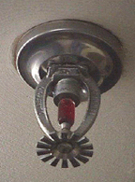
Project Safety – Site Safety Requirements
SDSs must be available for all hazardous materials present on the jobsite.
Sprinkler heads and sprinkler lines, as well as medical gas lines must be free from materials and objects at all times. Items such as temporary wiring and lighting are not permitted to be hung on this equipment at an time.
Emergency exit routes from the work site must be maintained free of obstructions.
Corridors outside of construction areas must remain clear.

Slide 17
Project Safety – Site Safety Requirements
Install temporary construction partitions made of limited combustible materials to provide smoke-tight separation between the construction areas and adjoining occupied areas.
Install and maintain temporary smoke or heat detection equipment and/or fire suppression system when an existing system is disabled.
Provide and maintain the required number and type of fire extinguishers in construction areas and temporary storage areas.
Provide documentation of hourly fire watch when fire alarm impairments last 4 or more hours in a 24-hour period and sprinkler system is out of service 8 hours or more in a 24-hour period.
Maintain fire watch for at least 30 minutes following hot work.

Slide 18
Project Safety – Emergency Planning
Emergency contacts and procedures must be posted and reviewed with all workers.
Orient contractors to project-specific emergency measures and procedures. Post the information in the work site.

Slide 19
Personal Protective Equipment (PPE)
Each contractor should follow the established protocols for determining the type and proper use of personal protective equipment (PPE).
A hazard assessment should be performed by the contractor to determine what PPE will be used. When new work or hazards are introduced into the worksite, a reassessment should be performed.

Slide 20
PPE Hazard Assessment
Eye and face protection shall be used when employees are exposed to activities such as flying debris and dust particles, chemical vapors and chemical splashes, and welding.
Head protection shall be used when there are hazards from falling or fixed objects.
Respiratory protection shall be worn if an exposure to respiratory hazards exist.
Hearing protection shall be worn if noise levels reach hazardous levels and/or if exposed to high noise levels for prolonged periods of time.

Slide 21
PPE Hazard Assessment
Fall protection measures, including temporary railing and fall arrest equipment must be used in accordance with OSHA requirement, including when working within 15 feet of unprotected edges, greater than 4 feet above the next working surface.
Railings must be at least 42” high and able to withstand 200# of applied force.
Foot protection shall be used when hazards exist from falling or rolling objects, punctures, or cuts.
Hand protection shall be used when hazards exist from chemical use, blood bodily fluid exposure, cuts, and burns.

Slide 22
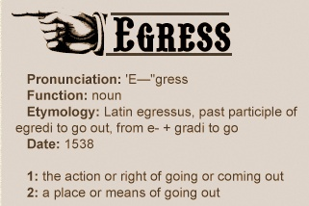
Building Life Safety Systems and Features Include:
Fire Alarm System
Emergency Egress Pathways and Discharge Points (hallways and stair towers)
Sprinkler System
Smoke & Fire Doors
Smoke & Fire Barriers

Slide 23
Interim Life Safety Measures (ILSM)
Life safety deficiencies occur when any facility activity temporarily compromises fire and life safety system or feature.
When life safety deficiencies exist interim measures or actions must be taken to temporarily reduce the hazard posed by life safety deficiencies.

Slide 24
Examples of Life Safety Deficiencies
A temporary construction barrier in an emergency exit hallway
A portion of the sprinkler system is shut down for several hours to re-rout a sprinkler line
A temporary entrance to the Emergency Department or Triage Department is built to accommodate a facility project

Slide 25
Contractor Daily Checklist
Are exits readily accessible?
Are exit signs in place?
Are smoke detectors covered during construction and uncovered at the end of each shift?
Are temporary partitions smoke tight?
Are Hot Work permits in place?
Are fire extinguishers in place?
Is PPE being used by all contractors?
Notes:
The general contractor is required to perform and document a daily safety inspection. This is then submitted to the Lancaster General Hospital Safety Department.

Slide 26
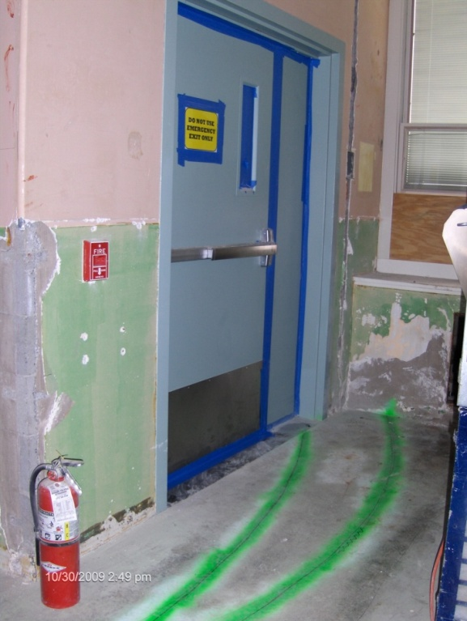
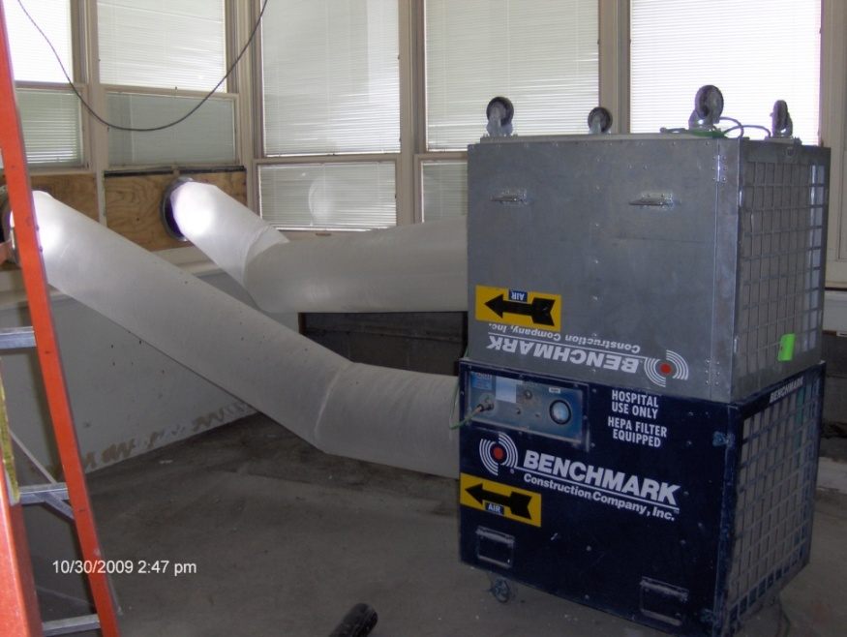
Work Site Practices
HEPA Machine for Infection Control Purposes
Emergency Exit
Fire Extinguisher
Fire Alarm Pull Station
Notes:
We are now going to review examples of good and bad work site practices.

Slide 27
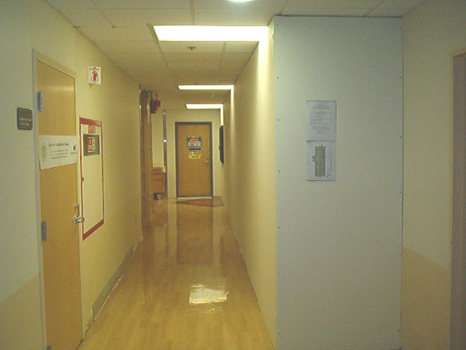
Smoke Tight Hard Barrier of Limited Combustible Materials – “Good”
Hard Barrier
ILSM Floor Plan
& Staff In-service
Walk off
Tacky Mat
Notes:
The wall on the right side is called an infection control barrier. This is a good example of this type of barrier since it is constructed of limited combustible materials, it appears to be smoke tight, and does not interfere with emergency exiting. There is also a walk off mat at the exit of the construction site, which is one method used to help control construction dust from being tracked throughout the building.

Slide 28
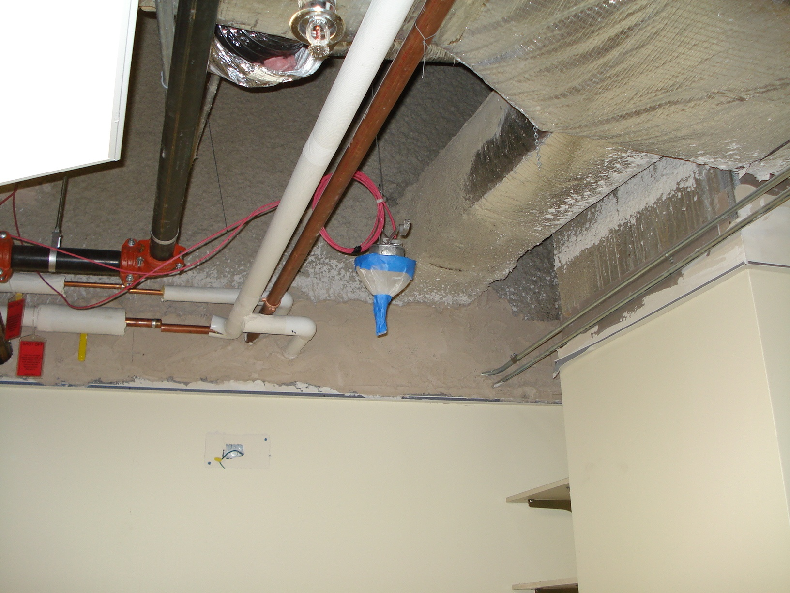
Covered Smoke Detector – “Good and Bad”
Notes:
This smoke detector is being covered by plastic and tape. This is good since it protects the smoke head from dust, which would likely cause the fire alarm to go off. This also bad if the smoke head is not uncovered before everyone leaves for the day. A smoke detector will not function properly if it is left covered.

Slide 29
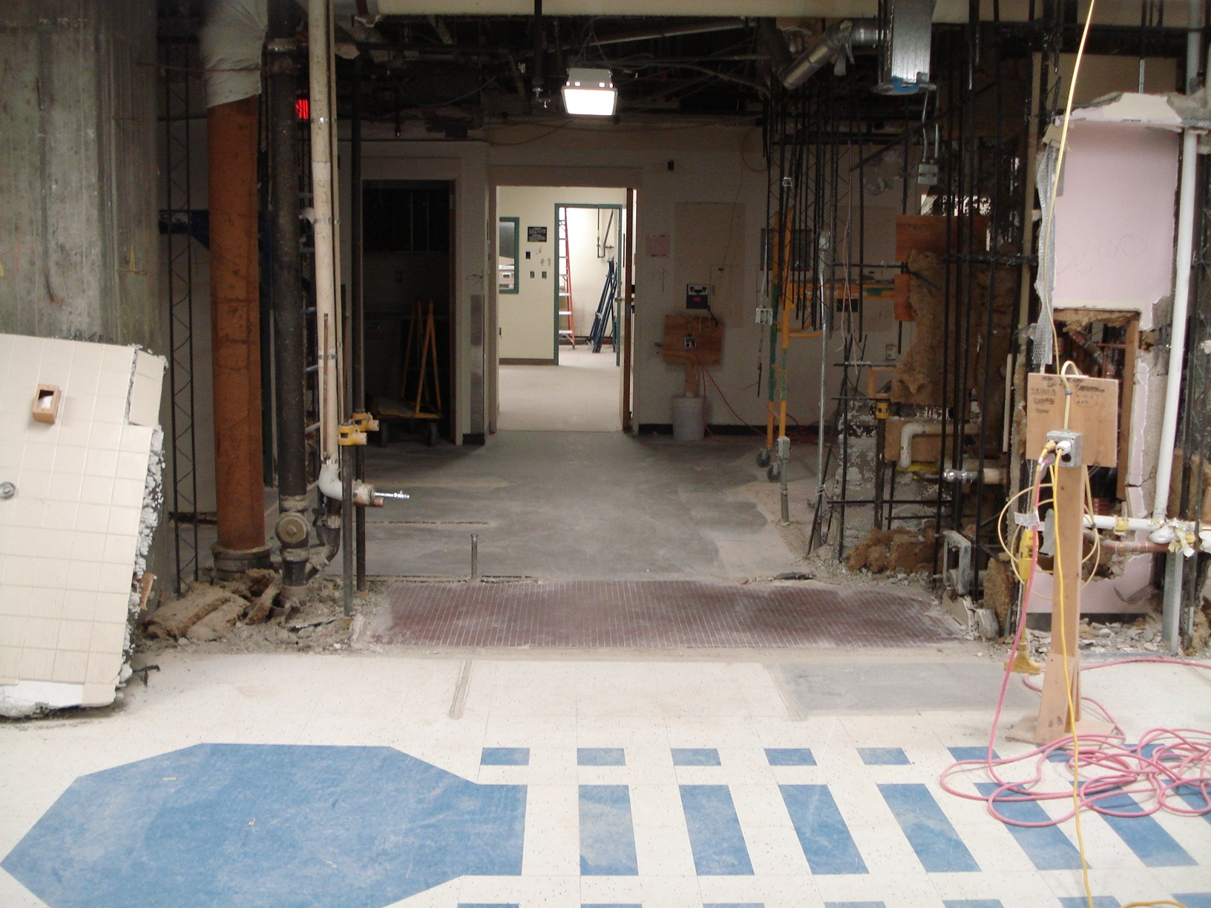
Demo & Housekeeping – “Good”
Clear of clutter and debris
Notes:
This demolition site is a great example good housekeeping practices. There is very little storage kept in this worksite and the emergency exit pathways are free of obstructions.

Slide 30
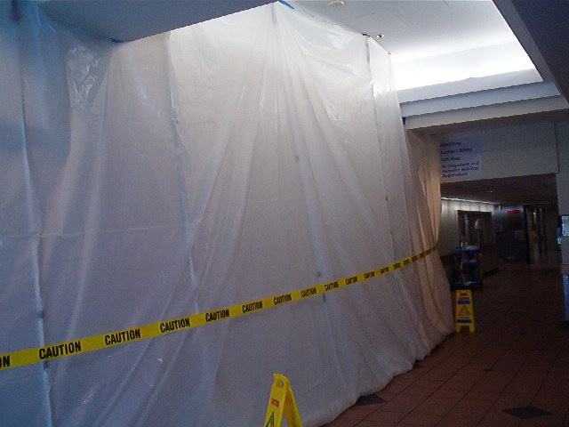
Hard Barrier Prep < 8 hrs
Soft Barrier – “Good” and “Bad”
Fire Rated Poly
Zip Poles
Barrier Tape
Corridor Width >5’
Signage
Notes:
Plastic sheets can be used on a very limited and short term basis to control dust and to provide a level of protection to building occupants for infection control measures; however plastic sheets do not meet the requirement for limited combustible material. Temporary construction barriers are to be smoke tight and built of noncombustible or limited combustible materials, such as sheet rock and gypsum, which are materials that will not contribute to the development or spread of fire.

Slide 31
Contact Information
Lancaster General Hospital Safety Department
Denise Parke, Safety Specialist
717.544.4844
Denise.Parke@Pennmedicine.upenn.edu
Angie Mackley, Director of Safety & Emergency Management
717.544.4772
Angela.Mackley@Pennmedicine.upenn.edu

